Slide 1
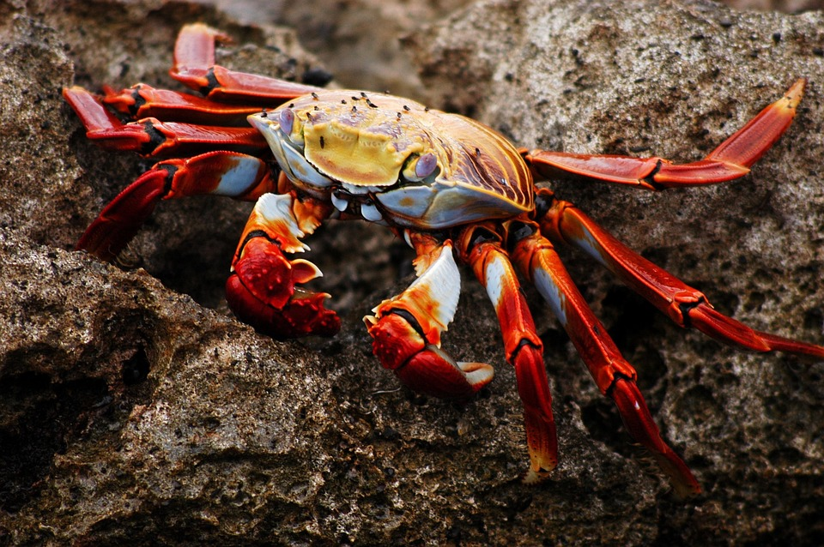
“Predicting Crab Age Using Regression Analysis” DDS DS 6306 Project 2
Presented By:
Tracy Dower
Sue Camara
Date: April 21, 2025

Slide 2

Objectives
Objective A: Build a regression model to predict the age of crabs using physical features
Objective B: Analyze the dataset to identify key relationships that influence crab age

Slide 3
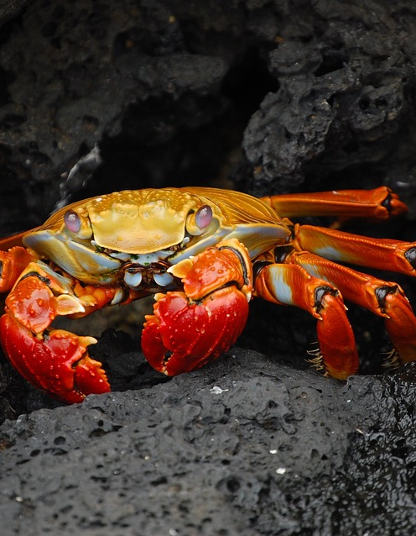
Why Predict Crab Age?
Helps scientists understand crab growth, reproductive cycles, and lifespan
Supports commercial fisheries and sustainability efforts
Can inform research on climate change and ocean pollution

Slide 4

Dataset Overview
Input Variables :
Sex
Length
Diameter
Height
Whole Weight
Shucked Weight
Viscera Weight
Shell Weight
Output Variable:
Age
(based on sensory data)

Slide 5



Evaluation Metric Mean Absolute Error
Measures the average magnitude of errors in predictions
Lower MAE
=
Better model accuracy
Formula displayed visually
Notes:
error used to evaluate the accuracy of predictions or models. MAE calculates the average of the absolute differences between predicted and actual values. MAE is a metric used in regression problems to measure the average magnitude of the errors in a set of predictions. It's calculated by:
Finding the absolute difference between each predicted value and the actual value.
Summing up all the absolute differences.
Dividing the sum by the total number of predictions.

Slide 6
Our Findings
Forecasting for success​
Key Metrics
Revenue by year
 | clients | orders | Gross avenue | Net revenue
20XX​ | 10​ | 1100​ | $10,000​ | $7,000​
20XX​ | 20​ | 200​ | $20,000​ | $16,000​
20XX​ | 30​ | 300​ | $30,000​ | $25,000​
20XX​ | 40​ | 400​ | $40,000​ | $30,000
Notes:
Replace with our findings from the crab data = Model selection: multiple regression techniques (e.g., Linear Regression, Random Forest, etc.)
Model tuning and validation

Slide 7
Key Insights from data analysis
Variables with strongest correlation with crab age
Patterns Discovered
Outliers or unusual relationships
​
Notes:
Patterns discovered: e.g., size-to-weight ratios, sex-based age differences

Slide 8
Final Model Performance
Notes:
Model used for final prediction MAE on validation/test set Comparison to baseline model if needed

Slide 9
Rshinny Dashboard Brief Overview of features
Notes:
RShiny Dashboard Brief overview of features:User inputs crab characteristics Dashboard returns predicted ageVisuals: screenshots or summary description

Slide 10
Conclusion & key takeaways
​
"Predicting crab age using physical characteristics offers reliable results while contributing important insights into their biology and environmental interactions. This study highlights opportunities for refining prediction models and guiding future research in marine science."
Notes:
Optional slide (if relevant to Olivia):We built a tool that can predict wine quality before tasting Helps spot potential issues early or test new blends Visual: Screenshot or mockup of prediction results

Slide 11
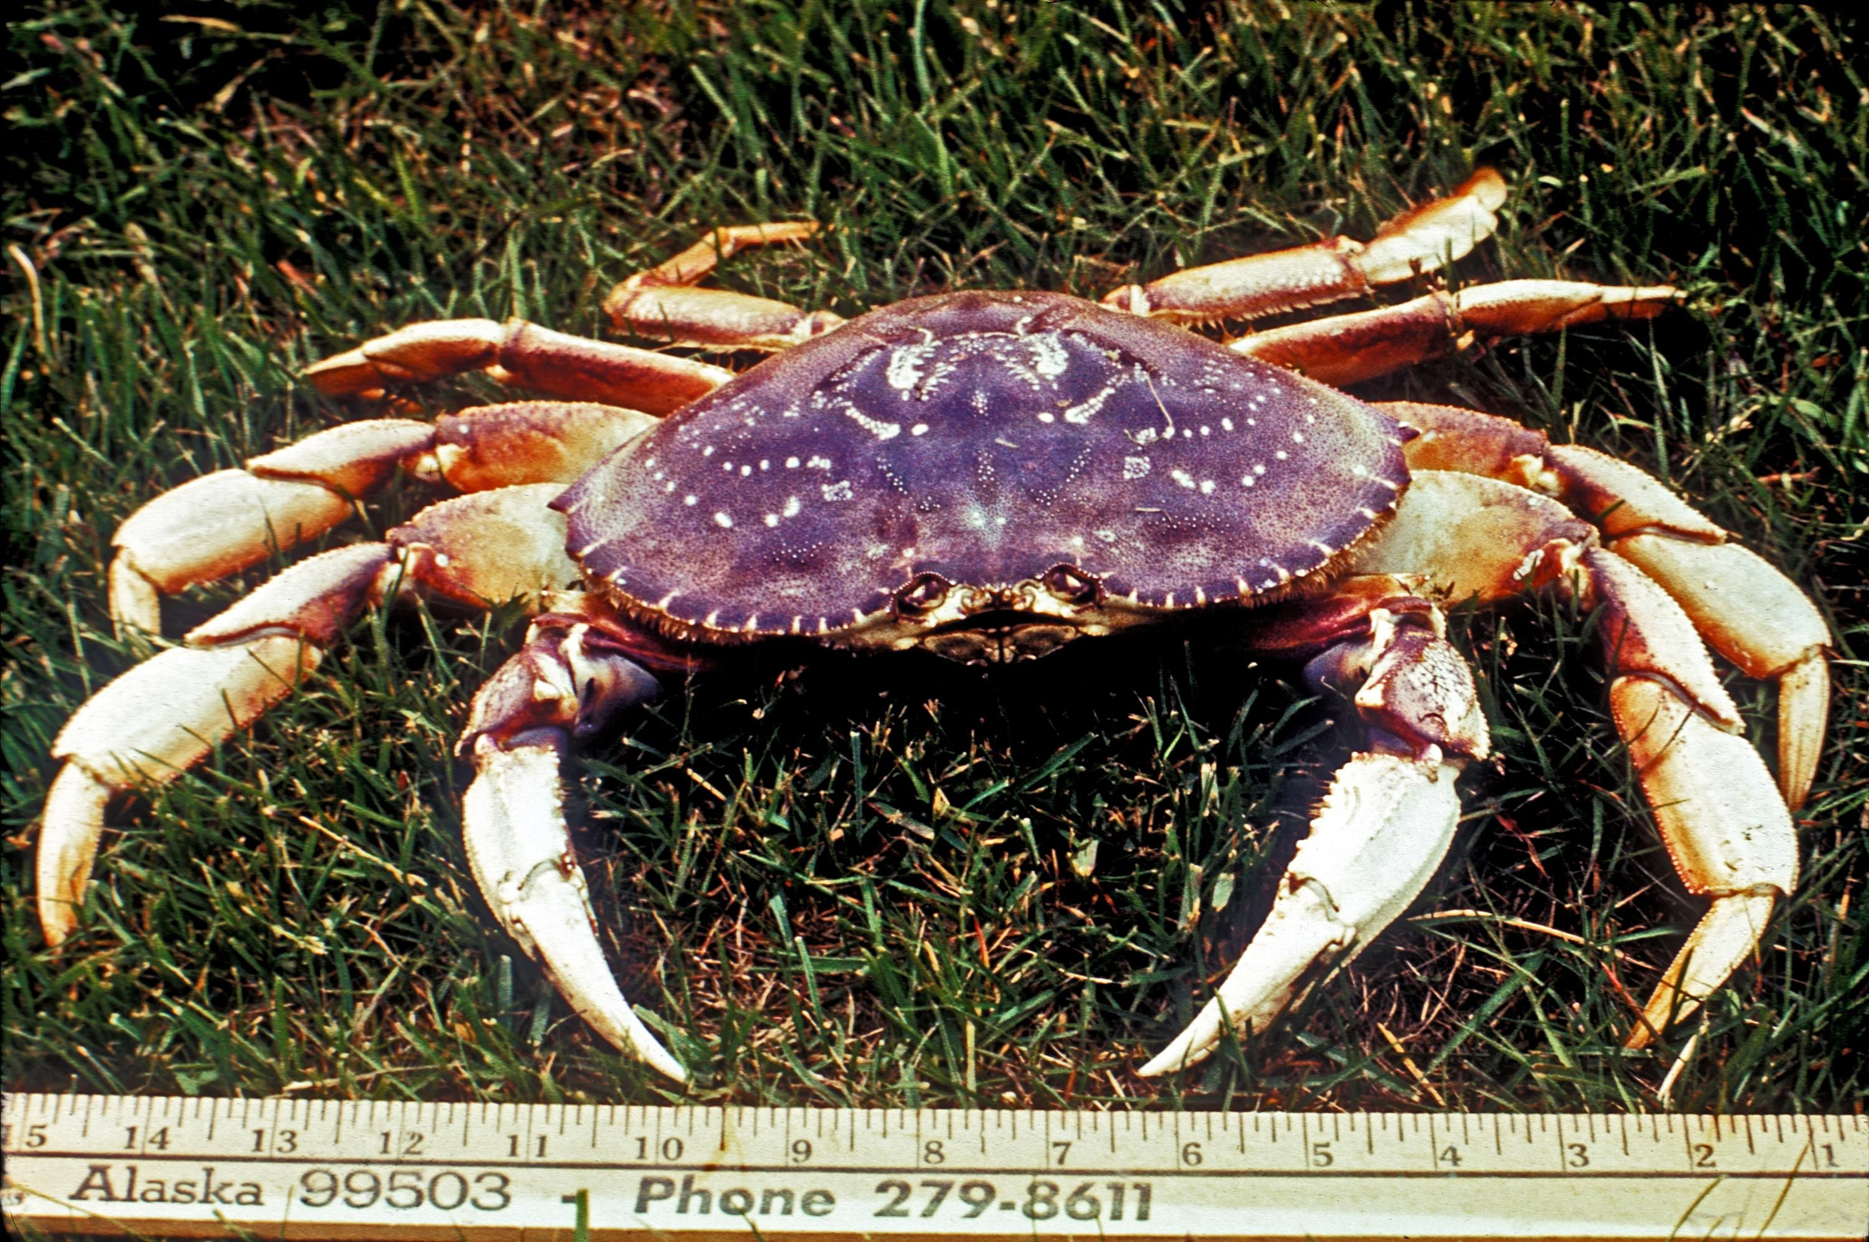
Thank you
Tracy Dower – tdower@smu.du
Sue Camara – scamara@smu.edu

